Slide 1
CMSC-447 Project
Karl Justice
Jerson Guansing
Darren Stevens II
Gene Burchette Victor Wu

Slide 2
Product Description
UMBC Bazaar is a web application to buy, sell and trade goods or services, which can be thought of as a mixture of Craig’s list, Ebay, and an online services market.
The intended audience is the development team and UMBC community.

Slide 3
The UMBC Bazaar web application consists of multiple use cases including, but not limited to:
account-based functionalities such as registering or updating user profile
product-based functionalities such as searching or adding products
transaction-based functionalities such as checking out and viewing order details

Slide 4
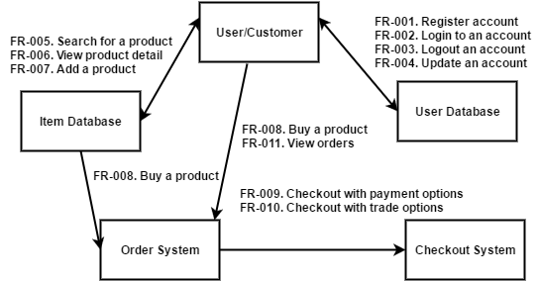
Requirements as specified by the guidelines for the project

Slide 5
Use Case Diagram

Slide 6
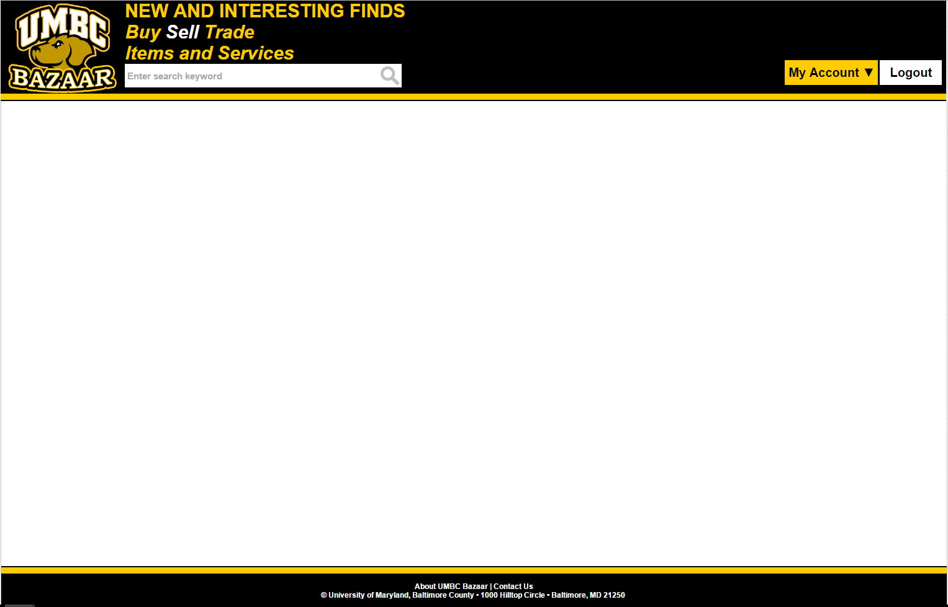

Notes:
There are certain aspects to the UMBC Bazaar layout that are consistent throughout the application. The UMBC Bazaar logo, for example, is contained in the top navigation bar, and shall appear in every page. The UMBC Bazaar logo serves as a hyperlink for users to get access the main page from any page

Slide 7
Notes:
Every page will be able to reach the About UMBC Bazaar and Contact Us screens.

Slide 8
Notes:
Furthermore, logged in users will have access to their My Accounts and Logout buttons. The My Accounts page will allow users to access other functionalities reserved for registered accounts such as updating profile, adding or updating products, and viewing orders. The Logout page will invalidate the current session and redirect the user back to the login page.

Slide 9
Site Navigation Flow
Notes:
Flow chart of how the site is laid out. We start with the Login page..

Slide 10
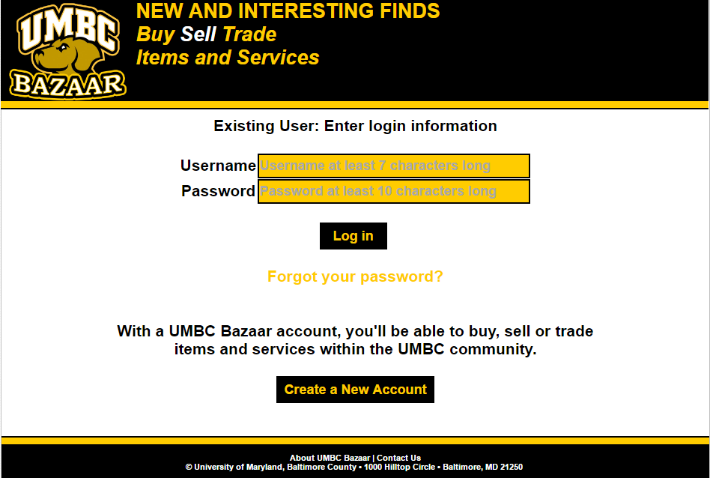
Notes:
This is the first page that users will see. The Login Page.
username textbox which requires only alphanumeric characters and between 7 to 50 characters long
Similarly, the password textbox must only be alphanumeric characters plus these special characters !@#$%
If the user credentials are valid, the user information will be saved on the session, and the user will be redirect to the main page.
We’ll follow through when we get to the demo.

Slide 11
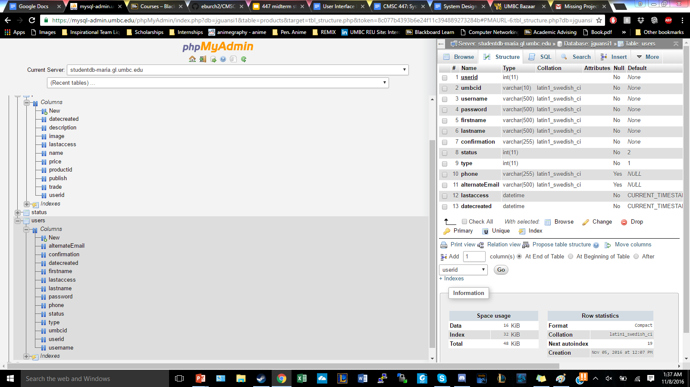
Notes:
Website is being built with the usual HTML, CSS, Javascript, PHP.
This is a snapshot of the MariaDB database that we’re using, which is based on MySQL but more robust.

Slide 12
Design Rationale

Slide 13
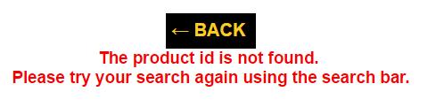
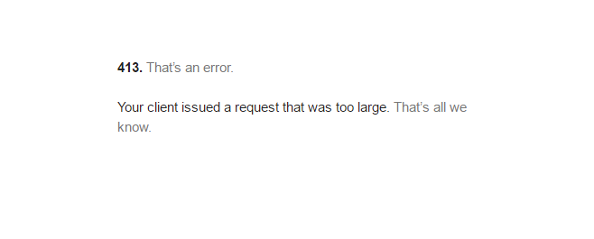
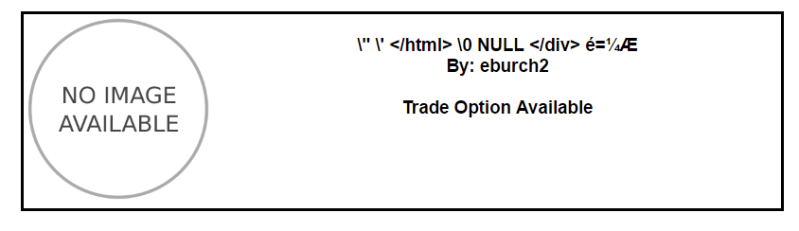
Testing
Case insensitive search: pass
SQL injection failsafe: pass
Stress test - very large search criteria: pass
Potential dangerous characters: pass

Slide 14
Status - 60% complete
Complete
Login
Registration
Forgot Password
Main Page
Add Product Page
Search Products
Profile
Incomplete
Buy products / Checkout
My Orders
Send a Message
Various tests

Slide 15
Problems
When we were designing our product, we initially planned on incorporating paypal as a payment option but later decided to only allow trade or CoD in the actual implementation.

Slide 16
Demo
https://userpages.umbc.edu/~jguansi1/CMSC447/login.php

